Slide 1

Oligopoly

Slide 2
Oligopoly
Exists when a small number of firms sell a product in a market with significant barriers to entry.
Few Firms
Differentiated or homogeneous product
High barriers to entry
Oligopolistic firms are Mutually interdependent
For example, market for cars in India is dominated by few firms (Maruti, Tata, Hyundai, Ford, Honda, etc.). A change by any one firm (say, Tata) in any of its vehicle (say, Indica) will induce other firms (say, Maruti, Hyundai, etc.) to make changes in their respective vehicles.
Non price competition (Advertising, better services to customers)

Slide 3
Oligopoly Examples
In India, markets for automobiles, cement, steel, aluminium, etc, are the examples of oligopolistic market. In all these markets, there are few firms for each particular product.
Automobile industry, Telecom industry- Differentiated product
In the case of natural gas, India is an oligopoly with two big players in the exploration and production (E&P) space and another two big players in the downstream, transmission and distribution (T&D) sector.
On the E&P side, just two contractors, Oil and Natural Gas Corp. Ltd (ONGC) and Reliance Industries Ltd (RIL). In the T&D sector, again, there are only two significant players, Gas Authority of India Ltd (GAIL) and its subsidiary GAIL Gas Ltd and RIL and its subsidiary Reliance Gas Ltd.

Slide 4
Game Theory
Game theory the study of how people behave strategic situations. We mean a situation in which a person choosing alternative course of action must consider how others might respond to the action he takes.
Oligopolistic firms have only a small number of firms, each firm must act strategically. Each firm knows that its profit depends not only on how much it produces but also on how much other firms produce.
Oligopolistic firm should consider how its decision might affect the production decision of all other firms.

Slide 5
Duopoly
An industry consisting of only two firms is duopoly.
DUOPOLY is a special case of oligopoly, in which there are exactly two sellers. Under duopoly, it is assumed that the product sold by the two firms is homogeneous and there is no substitute for it.
Examples where two companies control a large proportion of a market are: (i) Pepsi and Coca-Cola in the soft drink market; (ii) Airbus and Boeing in the commercial large jet aircraft market; (iii) Intel and AMD in the consumer desktop computer microprocessor market.

Slide 6
Price | Number of customers | Total revenue TR P ×Q
180 | 0 | 0
165 | 100 | 16500
150 | 200 | 30,000
135 | 300 | 40,500
120 | 400 | 48,000
105 | 500 | 52,500
90 | 600 | 54,000
75 | 700 | 52,500
60 | 800 | 48,000
45 | 900 | 40,500
30 | 1000 | 30,000
15 | 1100 | 16,500
0 | 1200 | 0

Slide 7
Collusions and cartels
Collusions Is an agreement among rival firms that specifies the price each firm charges and quantity it produces.
A cartel is a group of two or more firms that act in unison.
Eg. OPEC Cartel, Vitamin Cartel, Maple syrup cartel.
Mutual interdependence is a market situation where the actions of one firm have an impact on the price and output of its competitors.

Slide 8
Vitamin Cartel
The European Commission has imposed record fines of 855.22 million euros (£534m; $753m) on eight pharmaceutical companies for operating secret market sharing and price fixing cartels in the supply of vitamins throughout the 1990s.
The heaviest penalty of 462 million euros was handed out to the Swiss based multinational Hoffman-La Roche.
The investigators maintain that the company was the chief instigator and was involved in all 12 cartels that they uncovered.
Hoffmann-La Roche is the largest vitamin producer in the world, with about half of the overall market share.

Slide 9
Vitamin Cartel
The German company BASF, which is second in size only to Hoffman-La Roche, was accused of following its lead and was handed a penalty of 296.1 million euros.
Lower fines were imposed on three Japanese manufacturers and on a further trio of European companies—Merck KgaA (Germany), Solvay Pharmaceuticals BV (Netherlands), and Aventis SA (France).
The cartels concerned bulk synthetic substances which belong to the following groups of vitamins and closely related products: A, E, B1, B2, B5, B6, C, D3, Biotin (H), Folic Acid (M), Beta Carotene and carotinoids.

Slide 10
Vitamin Cartel
F. Hoffmann-La Roche AG (Switzerland): € 462 million
BASF AG (Germany): € 296.16 million
Aventis SA (France): € 5.04 million
Solvay Pharmaceuticals BV (Netherlands): € 9.10 million
Merck KgaA (Germany):€ 9.24 million
Daiichi Pharmaceutical Co Ltd (Japan): € 23.4 million
Eisai Co Ltd (Japan): € 13.23 million
Takeda Chemical Industries Ltd (Japan): € 37.05 million

Slide 11

Nash Equilibrium
A Nash equilibrium or second best outcome occurs when an economic decision maker has nothing to gain by changing strategy unless it can collude.

Slide 12
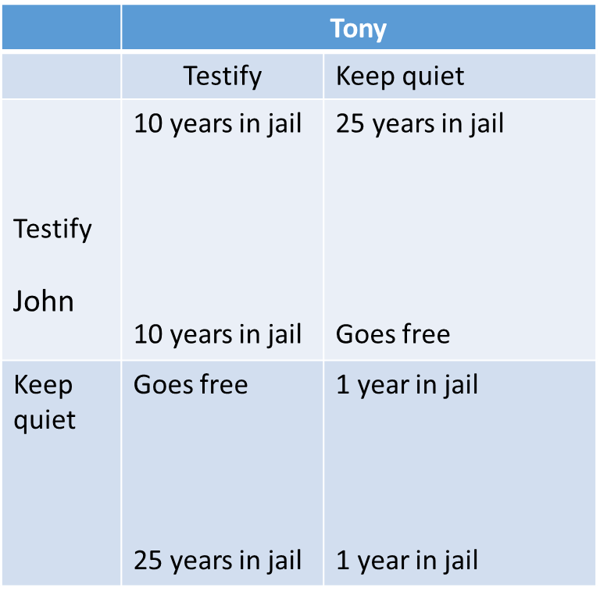
How does Game theory explain strategic behavior?
The prisoner’s dilemma occurs when decision makers face incentives that make it difficult to achieve mutually beneficial outcomes.
A dominant strategy exists when a player will always prefer one strategy regardless of what his opponent chooses.

Slide 13
Duopoly and Prisoner's dilemma
Horizon | Low production 300 customers | AT Phone
 |  | Low production 300 customers | High production 400 customers
 |  | $ 27000 revenue $ 27,000 revenue | $ 30,000 revenue $ 22,500 revenue
 | High production 400 customers | $ 22,500 revenue $ 30,000 revenue | $24,000 revenue $ 24,000 revenue
Each company has a dominant strategy to serve more customers because it makes the most revenue even if its competitor also expands production. A high level of production leads to a Nash equilibrium at which both firms make $ 24000.
75*400= 30,000
75*300=22,500
60*400=24000

